Slide 1
Object Detection Inferencing on PYNQ-Z2
T5: 吳泓毅、范詠為、林子軒
Advisor: Prof. Jiin Lai
Date: 2022/12/08

Slide 2
Outlines
Problem statement
Problem definition
Challenge
Objective
Project scope
Project plan
Reference

Slide 3
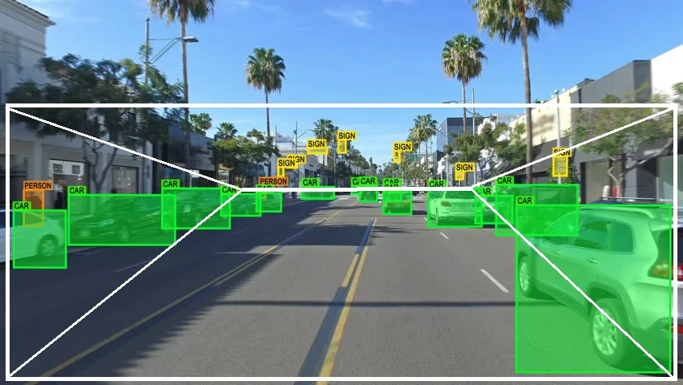

Introduction
Object Detection is widely applied in many areas of computer vision, including security, automatic vehicle systems, traffic monitoring, inventory management, and so on.

Slide 4
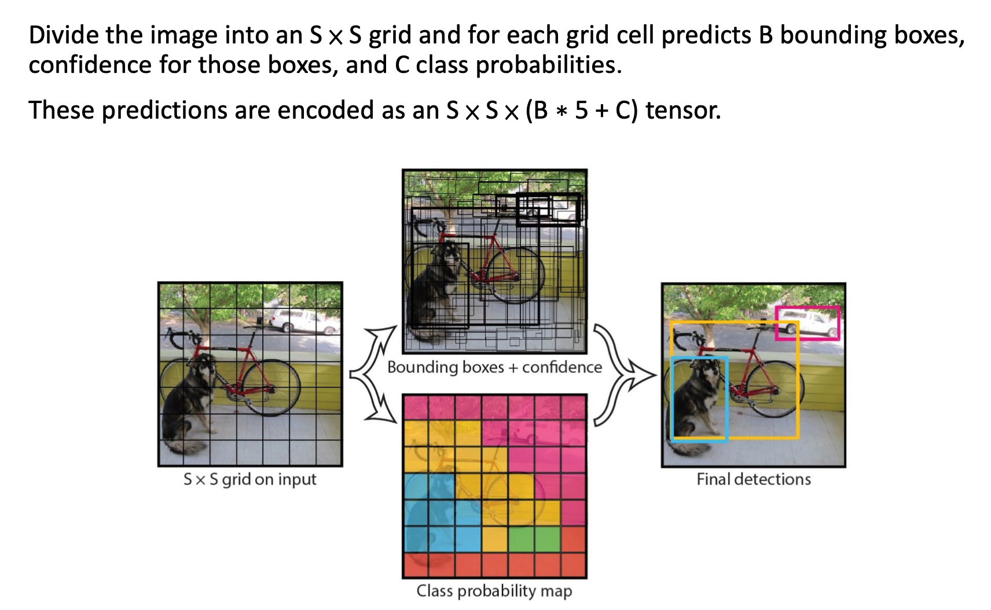
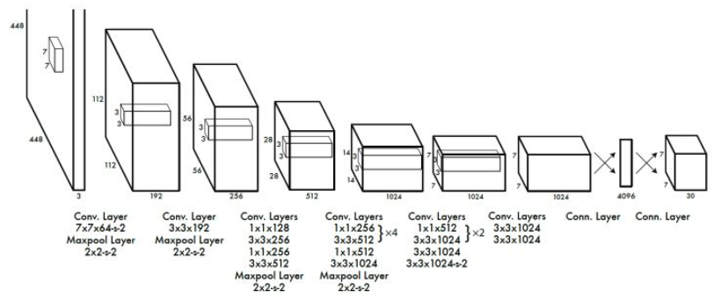
Object Detection
We plan to implement YOLOv1, which is an one-stage frameworks for object detection task.

Slide 5
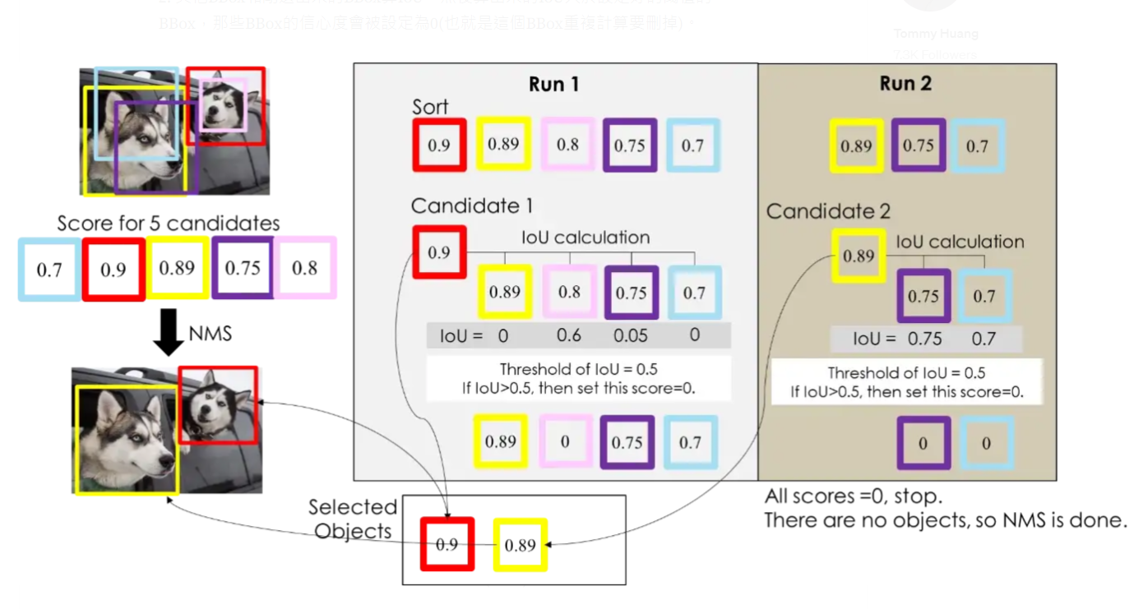
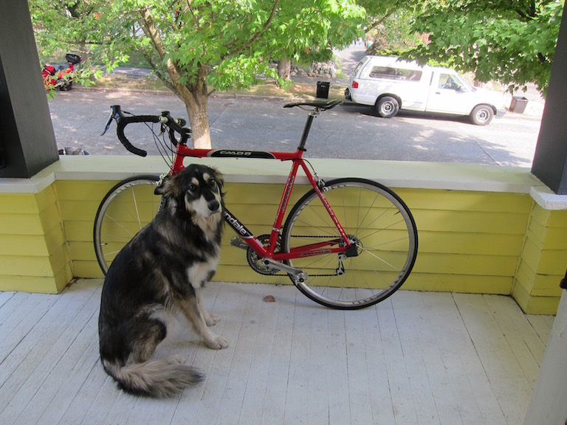
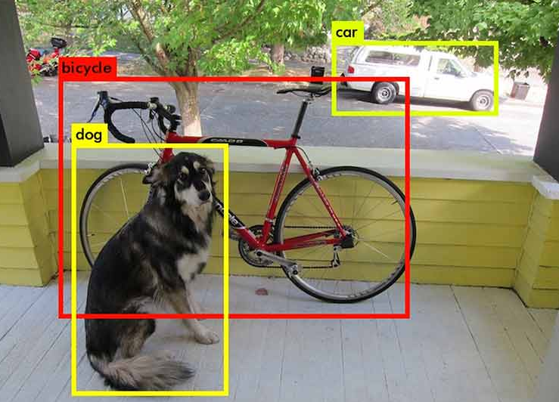
System Flow
Platform: PYNQ-Z2
input
image (3xHxW) (or sequence)
output
blended image (3xHxW) (or sequence)
3xHxW
image preprocessing
3x448x448
YOLOv1
SxSx(5B+C)
NMS
x,y,h,w,label
image blending
3xHxW

Slide 6
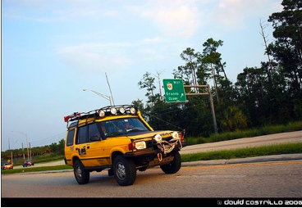
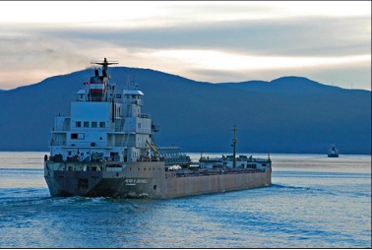
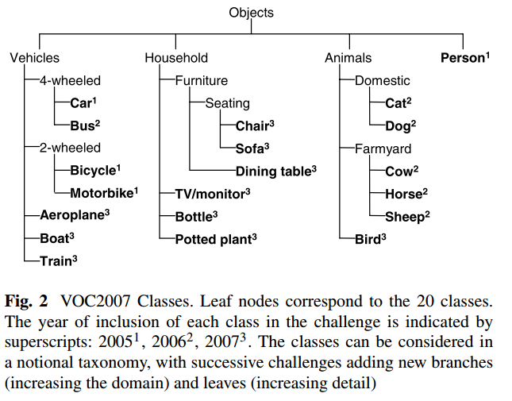

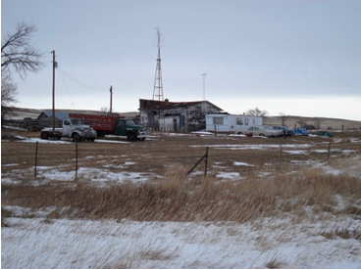
Dataset
PASCAL Visual Object Classes (VOC):
20 classes.
The train/val data has 11,530 images containing 27,450 ROI annotated objects and 6,929 segmentations.

Slide 7
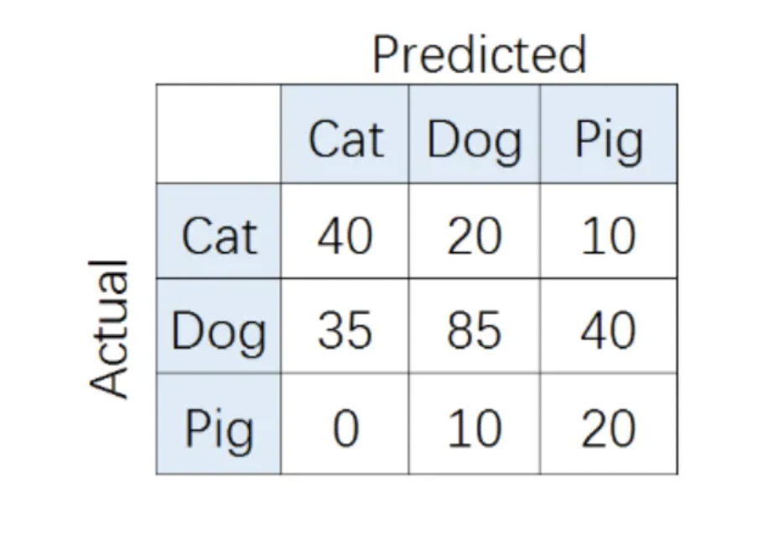
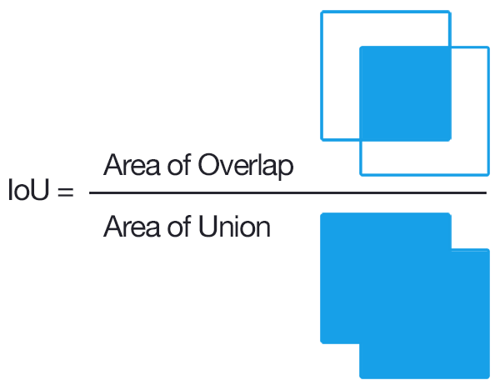
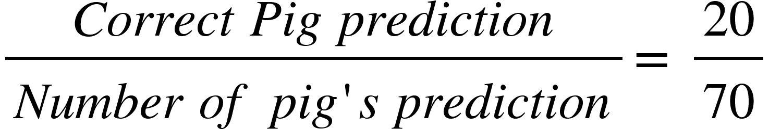
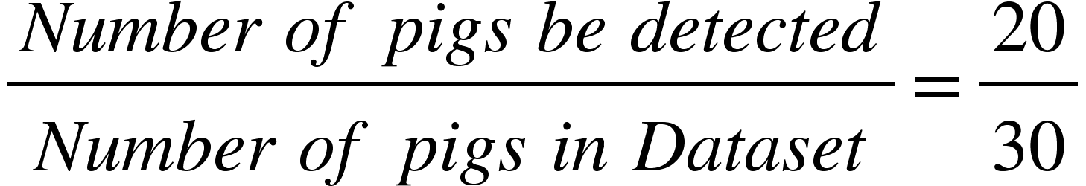
Evaluation - Definition of mAP
mAP: means of AP of all classes
use IOU(Intersection of GT and predicted box) to determine true positive and false positive
AP: average of recall points on PR(Precision-Recall) curve
Precision of pig
Recall of pig

Slide 8
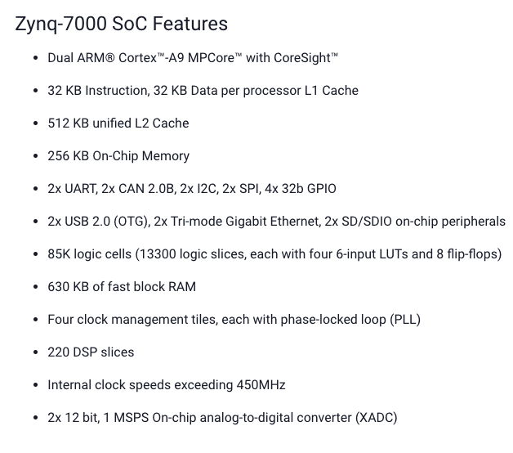
Challenge
Limited hardware resources on PYNQ board
Accuracy reduction

Slide 9
Objective
Downsize model to fit into FINN without sacrificing too many accuracy.
Performance of YOLOv1 on VOC
mAP = 63.4%
46 fps (real-time)
Find an effective way to determine best setting for each layer.
FINN supports different resource allocation for each model layer
FINN can evaluate resource usage at early stage
ref: https://paperswithcode.com/sota/real-time-object-detection-on-pascal-voc-2007

Slide 10
Project Plan
12/15 Pytorch implementation on GPU - 1w => 林
adjustable / flexible model architecture
12/15 Go through labD (FINN) - 1w => 范, 吳
12/22 Build network using FINN - 1w
image pre/post-processing, NMS function => 林
FINN model => 范
composable pipeline => 吳
12/28 Optimization, Result analysis (accuracy, area, throughput..) - 1w
12/29 Final presentation

Slide 11
Reference
Reference of final project: https://github.com/yth98/Xilinx-HLS/tree/master/Preprocess_CNN_Pipeline
Object detection network implemented by FINN: https://www.mdpi.com/2079-9268/12/2/30
YOLOv1’s paper: https://arxiv.org/pdf/1506.02640.pdf
VOC dataset information: http://host.robots.ox.ac.uk/pascal/VOC/
Introduction to PYNQ Composable Pipeline: https://www.youtube.com/watch?v=nkt7wSoExd8

Slide 12
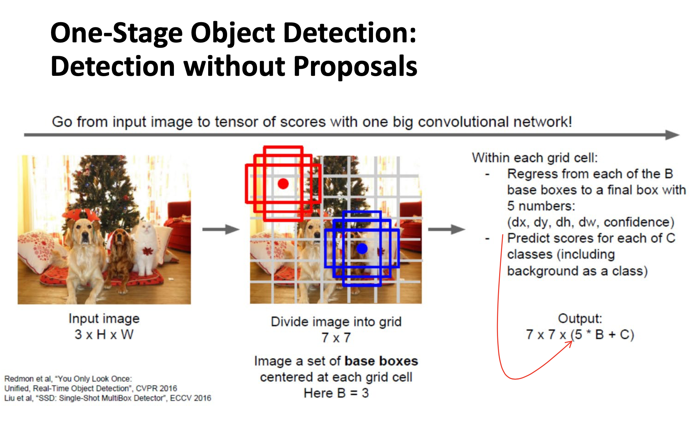
Appendix

